Slide 1
Yr 9 Revision Lesson 1.
Simple interest and Index laws

Slide 2
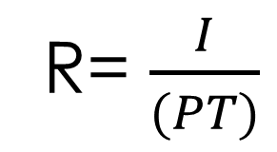
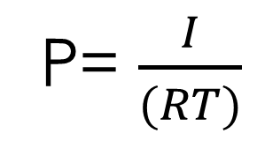
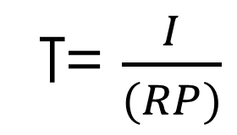
Simple Interest
Interest: The amount paid to a lender on top of the amount you burrowed.
Principal: The amount you either borrow or invest
Rate: The percentage rate per annum (pa means per year)
Time: The number of years you borrow or invest the principal.
I = PRT
P= $\frac{I}{(RT)}$
R= $\frac{I}{(PT)}$
T= $\frac{I}{(RP)}$
For each of these equations, rate is a decimal.
Decimal x100 = percentage percentage ÷ 100 = decimal

Slide 3
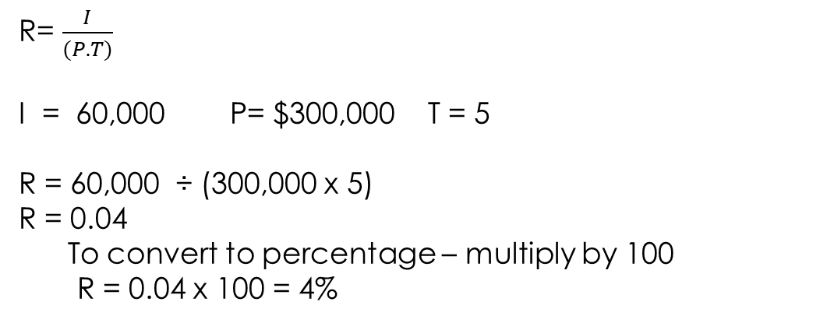
Anne has $40,000 in a savings account for 3 years that earns 6% annually. How much does she earn?
I = P.R.T
P = 40,000 R = 6 ÷ 100 = 0.06 T = 3
I = 40,000 x 0.06 x 3
I = $7,200
Mark has paid $60,000 in interest over 5 years on a $300,000 home load. What is the interest rate?
R= $\frac{I}{(P.T)}$
I = 60,000 P= $300,000 T = 5
R = 60,000 ÷ (300,000 x 5)
R = 0.04
To convert to percentage – multiply by 100
R = 0.04 x 100 = 4%

Slide 4
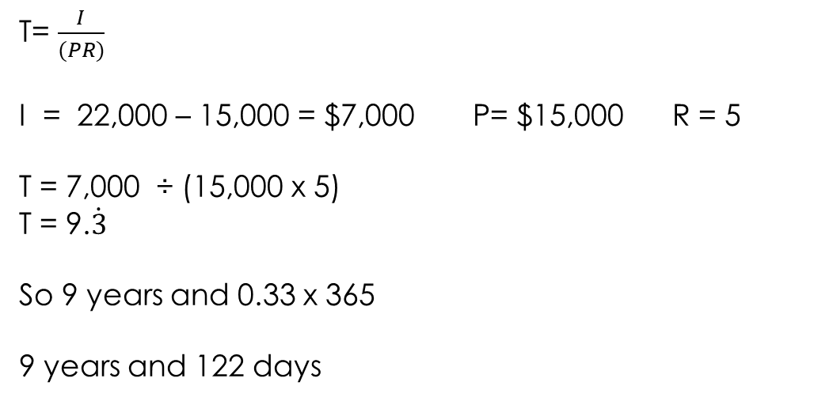
Robbo is burrowing $15,000 from his mate Davey. He says he will repay a total of $22,000 and that makes the loan worth 5% annually. How long is he planning on taking to repay the loan?
T= $\frac{I}{(PR)}$
I = 22,000 – 15,000 = $7,000 P= $15,000 R = 5
T = 7,000 ÷ (15,000 x 5)
T = 9.$\dot{3}$
So 9 years and 0.33 x 365
9 years and 122 days

Slide 5
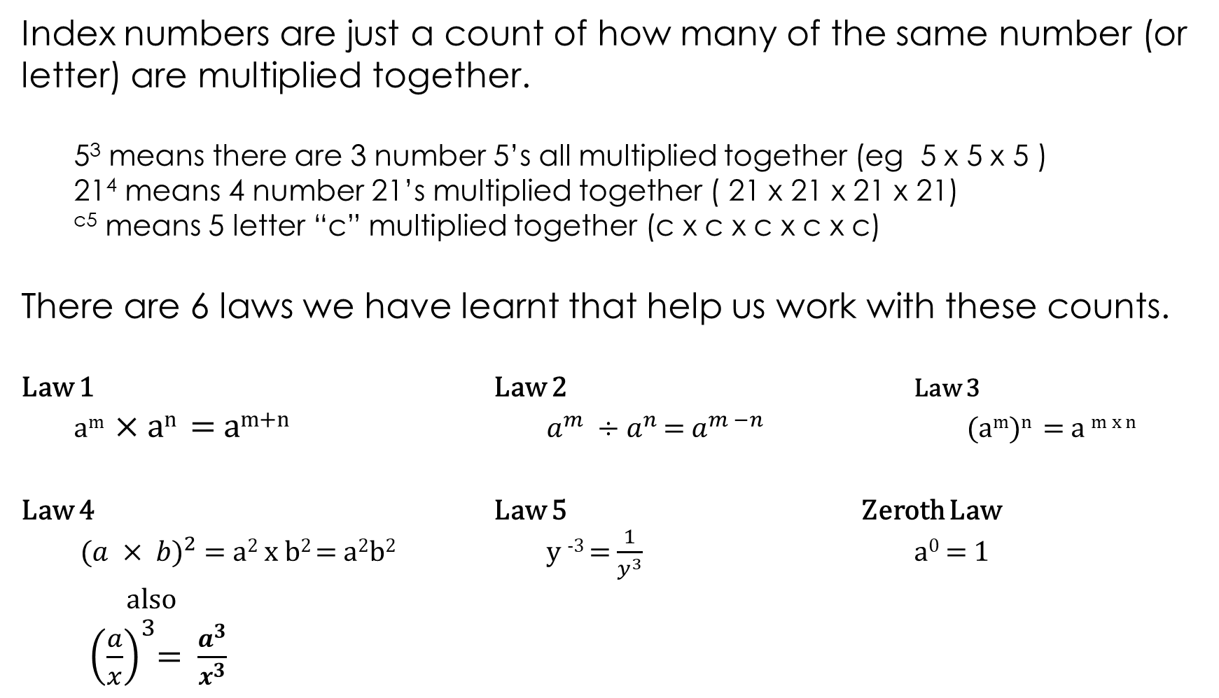
Index Laws
Index numbers are just a count of how many of the same number (or letter) are multiplied together.
5³ means there are 3 number 5’s all multiplied together (eg 5 x 5 x 5 )
21⁴ means 4 number 21’s multiplied together ( 21 x 21 x 21 x 21)
^{c5} means 5 letter “c” multiplied together (c x c x c x c x c)
There are 6 laws we have learnt that help us work with these counts.
Law 1 Law 2 Law 3
a^{m} × a^{n} = a^{m+n} $a^{m} ÷a^{n }$= $a^{m −n}$ (a^{m})^{n} = a ^{m x n}
Law 4 Law 5 Zeroth Law
($a × b)^{2}$ = a² x b² = a²b² y ⁻³ = $\frac{1}{y^{3}}$ a⁰ = 1
also
${\left(\frac{a}{x}\right)}^{3}$= $\frac{a^{3}}{x^{3}}$

Slide 6
Law 1 a^{m} × a^{n} = a^{m+n}
2⁴⁺³ = 2⁶ 5⁶⁺³ = 5⁹ 7²⁺⁴ = 7⁶ 8⁹⁺¹ = 8¹⁰
d²⁺¹= d³ y²⁺¹⁺⁴ = y⁷ b¹⁺⁵⁺² = b⁸ q⁶⁺³⁺² = q¹¹
5x3xm³⁺² = 15m⁵ 4x2xe⁴⁺² x f^{2x2} = 8e⁶f⁴ 20c⁷d² 18y²z⁷

Slide 7


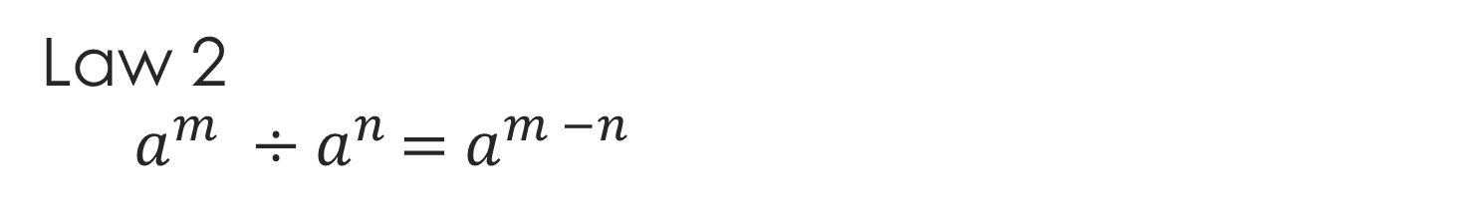
Law 2 $a^{m} ÷a^{n }$= $a^{m −n}$
a⁶⁻⁴ = a² x⁵⁻² = x³ q¹²⁻² = q¹⁰ d⁷⁻⁶ = d¹ = d
2b⁵ $\frac{1}{3}d$⁵ 2a⁷ 2y¹⁵⁻⁷ = 2y⁸

Slide 8

Index Law 3 (a^{m})^{n} = a ^{m x n}
y^{6x2} = y¹² m^{3x6} = m¹⁸ x^{2x5} = x¹⁰ b^{3x4} = b¹²
b⁵ x b⁹ = b¹⁴ a⁶ x a⁴ = a¹⁰ d¹² x d¹² = d²⁴ y¹² x y⁴ = y¹⁶

Slide 9

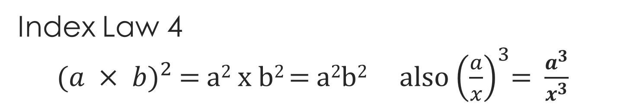
Index Law 4 ($a × b)^{2}$ = a² x b² = a²b² also ${\left(\frac{a}{x}\right)}^{3}$= $\frac{a^{3}}{x^{3}}$
2³x³ = 8x³ 5²y² = 25y² 4³a^{2x3} = 4³a⁶ 5⁴c⁸d¹²
$\frac{2^{2}}{r^{3x2}}= \frac{8}{r^{6}}$ $\frac{s^{6}}{7^{2}}= \frac{s^{6}}{49}$ $\frac{{2^{5}m}^{5}}{n^{5}}$ $\frac{{2^{3}a}^{6}}{3}$

Slide 10



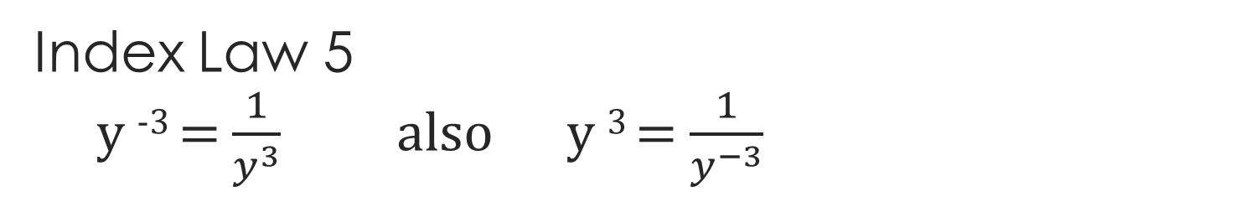
Index Law 5 y ⁻³ = $\frac{1}{y^{3}}$ also y ³ = $\frac{1}{y^{−3}}$
$\frac{1}{x}$ $\frac{1}{a^{4}}$ m⁵ $x$⁴
$\frac{5a^{2}b^{2}}{6c^{4}d^{}}$ $\frac{4h^{3}m^{2}}{5k^{2}p}$

Slide 11

Zeroth Law a⁰ = 1
Solve the following
5⁰ = b) 6 x 3⁰ = c) d⁰ =
d) 5s⁰ = e) 4f⁰ – e⁰ = f) (t – 21g²)⁰ =
e) $6\left(412 − {13t}^{x}\right)$⁰ – ${\left(\frac{r^{13}}{3^{rty}}\right)}^{0}$ =
$1$ 6x1 = 6 1
5x1 = 5 4-1 = 3 1
6-1 = 5

